Slide 1
Reinforcement Learning
Geoff Hulten

Slide 2
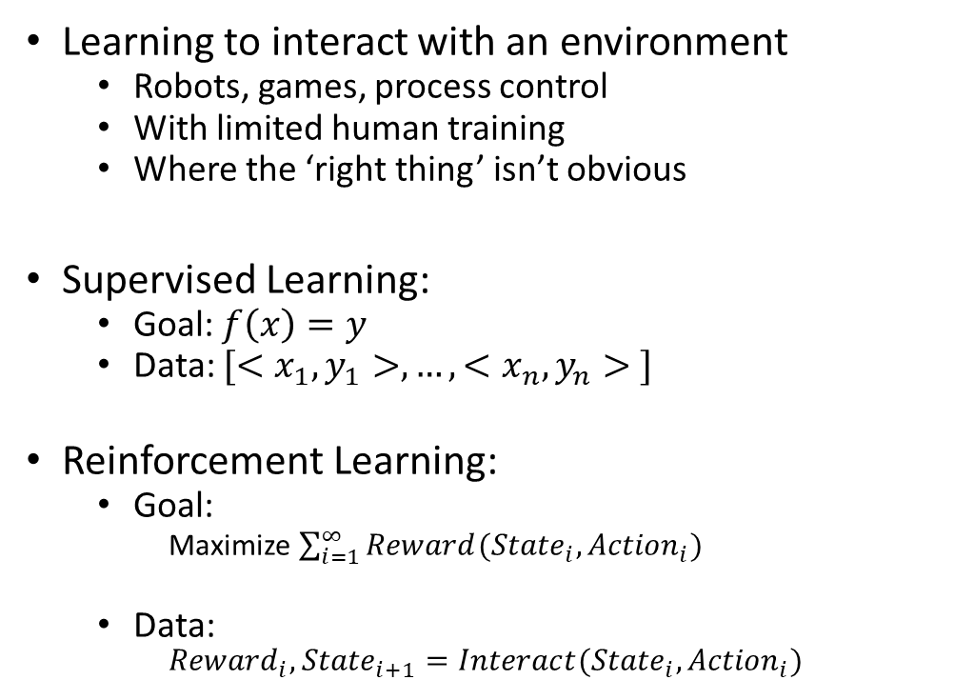
Reinforcement Learning
Learning to interact with an environment
  Robots, games, process control
  With limited human training
  Where the ‘right thing’ isn’t obvious
Supervised Learning:
  Goal: $f\left(x\right)=y$
  Data: ${[<x}_{1},y_{1}>, …, {<x}_{n},y_{n}> ]$
Reinforcement Learning:
  Goal:
    Maximize $\sum_{i=1}^{∞}{Reward({{State}_{i}, Action}_{i})}$
  Data:
    $${Reward}_{i}, {State}_{i+1}=Interact({State}_{i},{Action}_{i})$$
Agent
Reward
State
Action
Environment

Slide 3
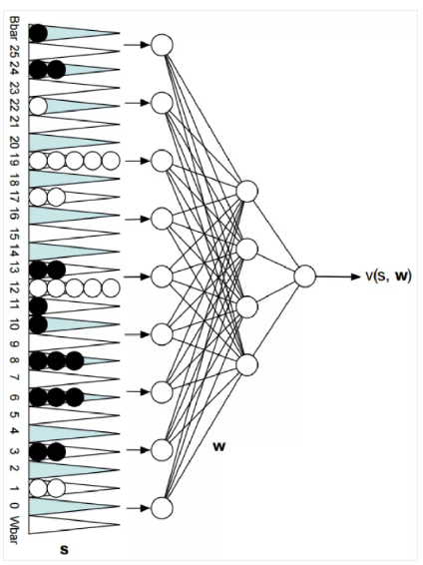
TD-Gammon – Tesauro ~1995
State: Board State
Actions: Valid Moves
Reward: Win or Lose
Net with 80 hidden units, initialize to random weights
Select move based on network estimate & shallow search
Learn by playing against itself
1.5 million games of training
-> competitive with world class players
P(win)

Slide 4
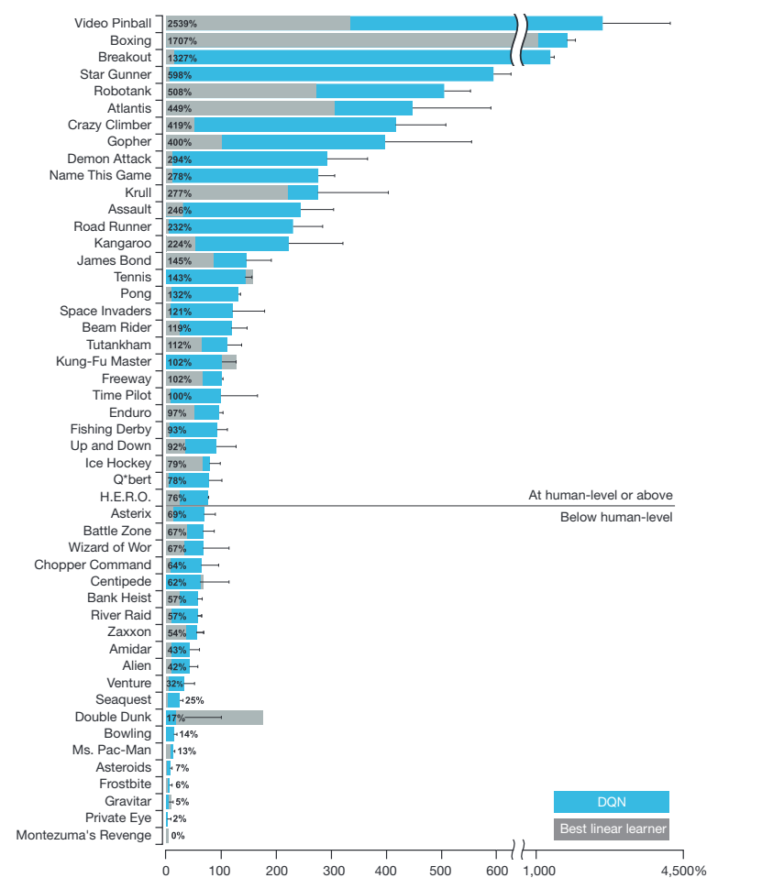
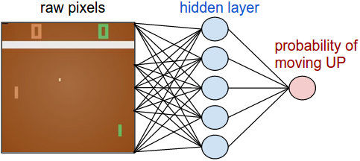
Atari 2600 games
State: Raw Pixels
Actions: Valid Moves
Reward: Game Score
Same model/parameters for ~50 games
https://storage.googleapis.com/deepmind-media/dqn/DQNNaturePaper.pdf

Slide 5
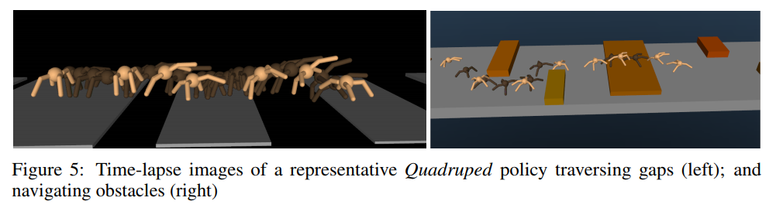
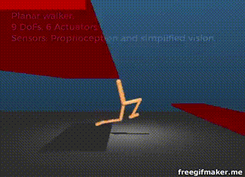
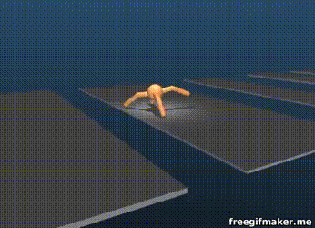
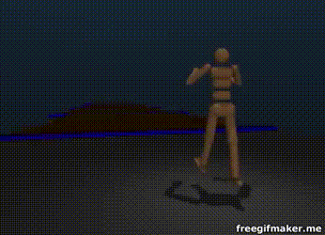
Robotics and
Locomotion
State:
Joint States/Velocities
Accelerometer/Gyroscope
Terrain
Actions: Apply Torque to Joints
Reward: Velocity – { stuff }
https://youtu.be/hx_bgoTF7bs
2017 paper https://arxiv.org/pdf/1707.02286.pdf

Slide 6
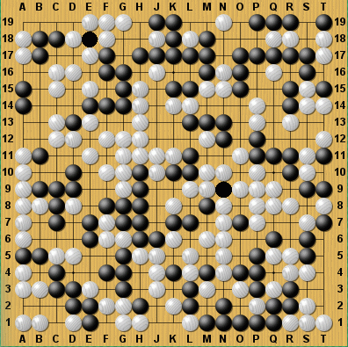
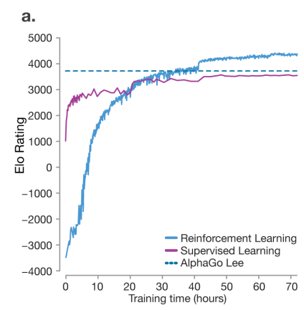
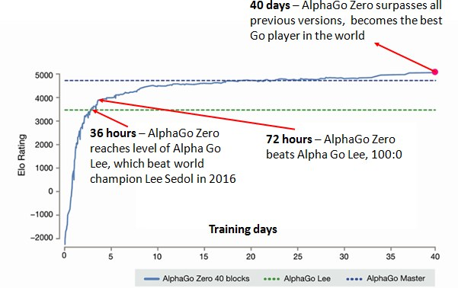
Alpha Go
State: Board State
Actions: Valid Moves
Reward: Win or Lose
Learning how to beat humans at ‘hard’ games (search space too big)
Far surpasses (Human) Supervised learning
Algorithm learned to outplay humans at chess in 24 hours
https://deepmind.com/documents/119/agz_unformatted_nature.pdf

Slide 7
How Reinforcement Learning is Different
Delayed Reward
Agent chooses training data
Explore vs Exploit (Life long learning)
Very different terminology (can be confusing)

Slide 8
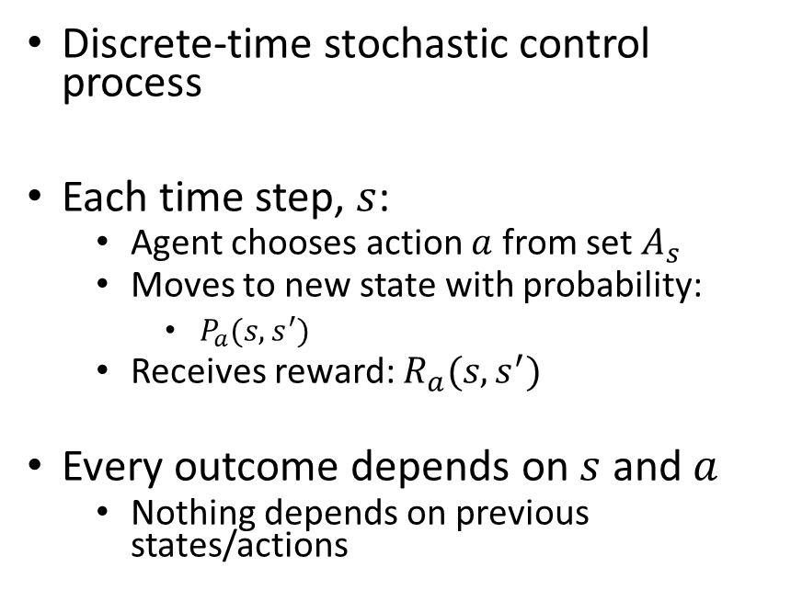
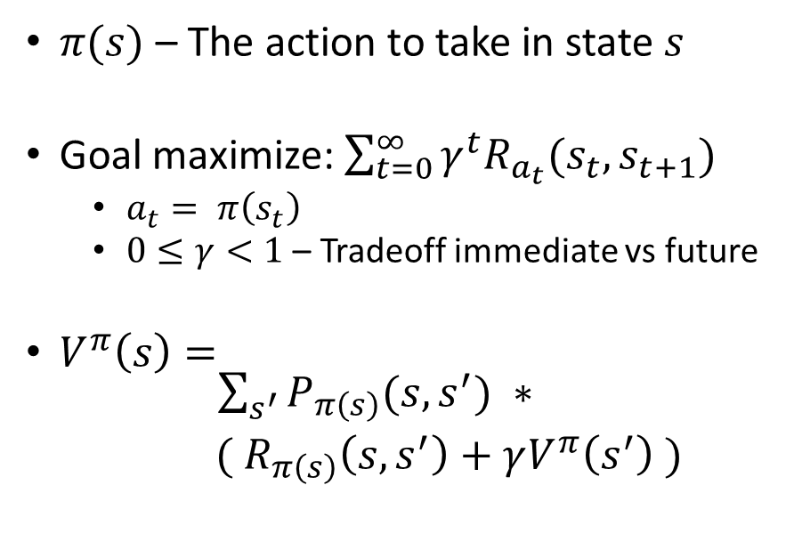
Setup for Reinforcement Learning
Markov Decision Process (environment)
Policy
(agent’s behavior)
Discrete-time stochastic control process
Each time step, $s$:
  Agent chooses action $a$ from set $A_{s}$
  Moves to new state with probability:
    $P_{a}(s, s^{′})$
  Receives reward: $R_{a}(s, s^{′})$
Every outcome depends on $s$ and $a$
  Nothing depends on previous states/actions
$π(s)$ – The action to take in state $s$
Goal maximize:$\sum_{t=0}^{∞}{γ^{t}R_{a_{t}}(s_{t},s_{t+1})}$
  $a_{t}= π\left(s_{t}\right)$
  $0≤γ<1$ – Tradeoff immediate vs future
$V^{π}\left(s\right)= \begin{matrix}\sum_{s^{′}}{P_{π\left(s\right)}(s,s^{′})} ∗ \\ ({ R}_{π\left(s\right)}\left(s,s^{′}\right)+γV^{π}\left(s^{′}\right) )\end{matrix}$
Probability of moving to each state
Reward for making that move
Value of being in that state

Slide 9









Simple Example of Agent in an Environment
State:
Map Locations
$\{<0,0>, <1,0>…<3,3>\}$
Actions:
Move within map
Reaching chest ends episode
$A_{0,0}=\{ east, south \}$
$A_{1,0}=\{ east, south, west \}$
$A_{2,0}=\left\{ φ \right\}$
…
$A_{2,2}=\{ north, west \}$
Reward:
100 at chest
0 for others
$R_{east}\left(<1,0>, <2,0>\right)=100$
$R_{north}\left(<2,1>, <2,0>\right)=100$
$R_{∗}\left(∗, ∗\right)=0$
Score: 0
Score: 100
0, 0
1, 0
2, 0
100
0, 1
1, 1
2, 1
0, 2
1, 2
2, 2

Slide 10
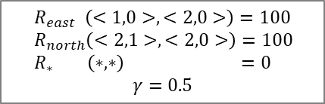

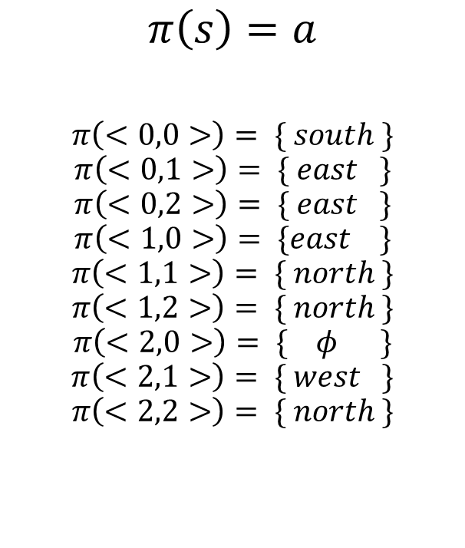
Policies
$R_{east} \left(<1,0>, <2,0>\right)=100$
$R_{north}\left(<2,1>, <2,0>\right)=100$
$R_{∗} \left(∗, ∗\right) =0$
$$γ=0.5$$
Policy
Evaluating Policies
$$π\left(s\right)=a$$
$$π\left(<0,0>\right)= \{ south \}$$
$$π\left(<0,1>\right)= \{ east \}$$
$$π\left(<0,2>\right)= \{ east \}$$
$$π\left(<1,0>\right)= \{east \}$$
$$π\left(<1,1>\right)= \{ north \}$$
$$π\left(<1,2>\right)= \{ north \}$$
$$π\left(<2,0>\right)= \{ φ \}$$
$$π\left(<2,1>\right)= \{ west \}$$
$$π\left(<2,2>\right)= \{ north \}$$
0, 0
1, 0
2, 0
$$V^{π}\left(s\right)=\sum_{i=0}^{∞}{γ^{i}}r_{i+1}$$
$$V^{π}\left(<1,0>\right)=γ^{0} ∗100$$
$$V^{π}\left(<1,1>\right)=γ^{0}∗0+ γ^{1} ∗100$$
12.5
100
0, 1
1, 1
2, 1
50
0, 2
1, 2
2, 2
Move to <0,1>
Move to <1,1>
Move to <1,0>
Move to <2,0>
$$V^{π}\left(<0,0>\right)=γ^{0}∗0+ γ^{1} ∗0+γ^{2} ∗0+γ^{3} ∗100$$
Policy could be better

Slide 11
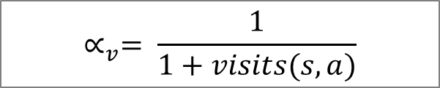
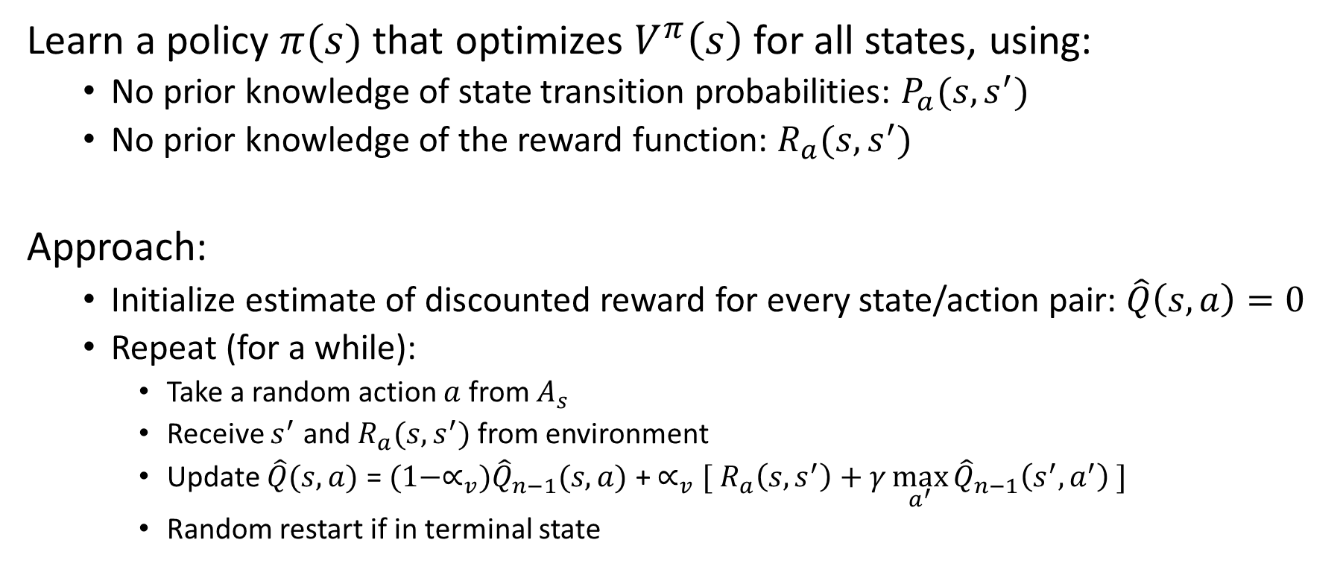


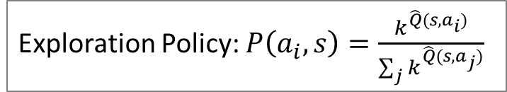
Q learning
Learn a policy $π(s)$ that optimizes $V^{π}\left(s\right)$for all states, using:
  No prior knowledge of state transition probabilities: $P_{a}(s, s^{′})$
  No prior knowledge of the reward function: $R_{a}(s, s^{′})$
Approach:
  Initialize estimate of discounted reward for every state/action pair: $\hat{Q}\left(s,a\right)=0$
  Repeat (for a while):
    Take a random action $a$ from $A_{s}$
    Receive $s^{′}$ and $R_{a}(s, s^{′})$ from environment
    Update $\hat{Q}(s,a)$ = $(1−∝_{v}){\hat{Q}}_{n−1}(s,a)$ + $∝_{v}[{ R}_{a}\left(s, s^{′}\right)+γ\max_{a^{′}}{{\hat{Q}}_{n−1}\left(s^{′},a^{′}\right)} ]$
    Random restart if in terminal state
${ R}_{a}\left(s, s^{′}\right)+γ\max_{a^{′}}{\hat{Q}\left(s^{′},a^{′}\right)}$
$$∝_{v}= \frac{1}{1+visits(s,a)}$$
Exploration Policy: $P\left(a_{i},s\right)=\frac{k^{\hat{Q}(s,a_{i})}}{\sum_{j}{k^{\hat{Q}(s,a_{j})}}}$
$$π\left(s\right)=\underset{aεA_{s}}{argmax}{\hat{Q}(s,a)}$$

Slide 12
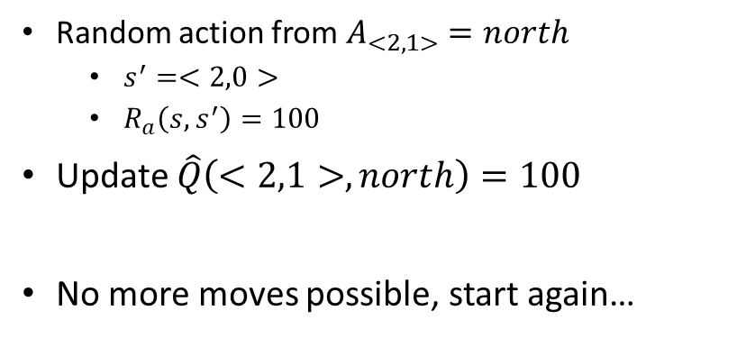

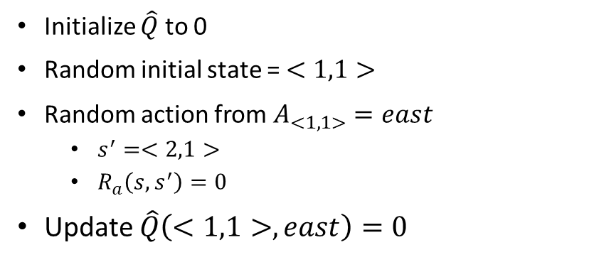
Example of Q learning
(round 1)
Initialize $\hat{Q}$ to 0
Random initial state = $<1,1>$
Random action from $A_{<1,1>}=east$
  $s^{′}=<2,1>$
  $R_{a}\left(s, s^{′}\right)=0$
Update $\hat{Q}\left(<1,1>,east\right)=0$
0, 0
1, 0
2, 0
0
0
0
0
0
0
0
100
0, 1
1, 1
0
0
0
2, 1
0
0
0
Random action from $A_{<2,1>}=north$
  $s^{′}=<2,0>$
  $R_{a}\left(s, s^{′}\right)=100$
Update $\hat{Q}\left(<2,1>,north\right)=100$
No more moves possible, start again…
0
0
0
0
0
0, 2
1, 2
0
2, 2
0
0
0
$\hat{Q}\left(s,a\right)={ R}_{a}\left(s, s^{′}\right)+γ\max_{a^{′}}{{\hat{Q}}_{n−1}\left(s^{′},a^{′}\right)}$

Slide 13


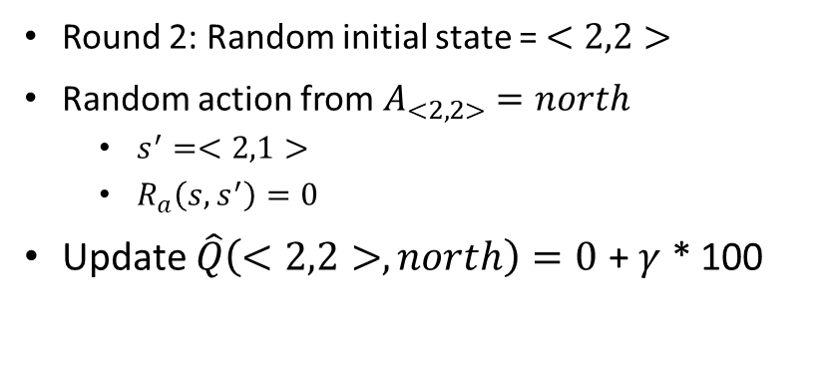
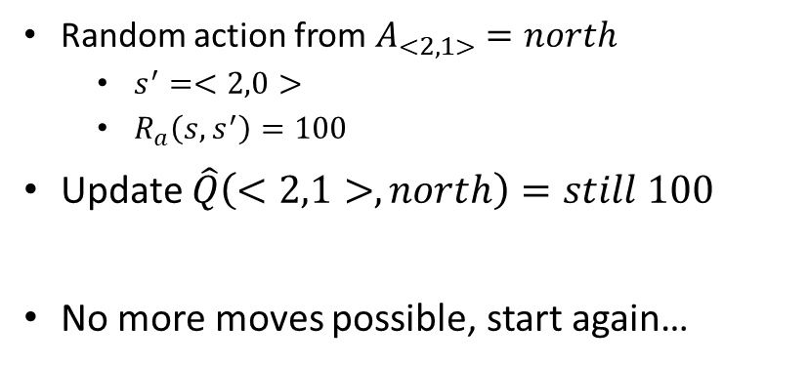
Example of Q learning
(round 2)
Round 2: Random initial state = $<2,2>$
Random action from $A_{<2,2>}=north$
  $s^{′}=<2,1>$
  $R_{a}\left(s, s^{′}\right)=0$
Update $\hat{Q}\left(<2,2>,north\right)=0$ + $γ$ * 100
0, 0
1, 0
2, 0
0
0
0
0
0
0
0
100
0, 1
0
1, 1
2, 1
0
0
0
0
Random action from $A_{<2,1>}=north$
  $s^{′}=<2,0>$
  $R_{a}\left(s, s^{′}\right)=100$
Update $\hat{Q}\left(<2,1>,north\right)=still 100$
No more moves possible, start again…
0
0
0
50
0
0
0, 2
1, 2
0
2, 2
0
0
0
$\hat{Q}\left(s,a\right)={ R}_{a}\left(s, s^{′}\right)+γ\max_{a^{′}}{{\hat{Q}}_{n−1}\left(s^{′},a^{′}\right)}$
$$γ=0.5$$

Slide 14
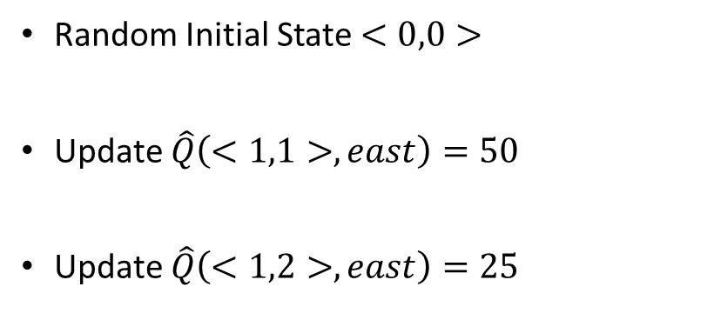


Example of Q learning
(some acceleration…)
$\hat{Q}\left(s,a\right)={ R}_{a}\left(s, s^{′}\right)+γ\max_{a^{′}}{{\hat{Q}}_{n−1}\left(s^{′},a^{′}\right)}$
$$γ=0.5$$
Random Initial State $<0,0>$
Update $\hat{Q}\left(<1,1>,east\right)=50$
Update $\hat{Q}\left(<1,2>,east\right)=25$
0, 0
1, 0
2, 0
0
0
0
0
0
0
0
100
0, 1
0
1, 1
2, 1
50
0
0
0
0
0
0
0
50
0
0, 2
1, 2
25
2, 2
0
0
0
0

Slide 15
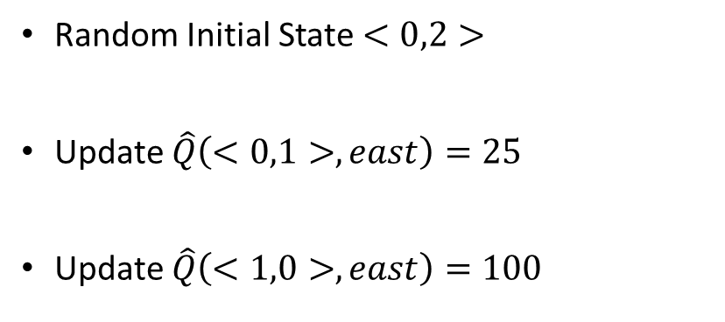
Example of Q learning
(some acceleration…)
$\hat{Q}\left(s,a\right)={ R}_{a}\left(s, s^{′}\right)+γ\max_{a^{′}}{{\hat{Q}}_{n−1}\left(s^{′},a^{′}\right)}$
$$γ=0.5$$
Random Initial State $<0,2>$
Update $\hat{Q}\left(<0,1>,east\right)=25$
Update $\hat{Q}\left(<1,0>,east\right)=100$
0, 0
1, 0
2, 0
0
0
100
0
0
0
0
0
100
0, 1
0
1, 1
2, 1
25
50
0
0
0
0
0
0
50
0
0, 2
1, 2
25
2, 2
0
0
0

Slide 16

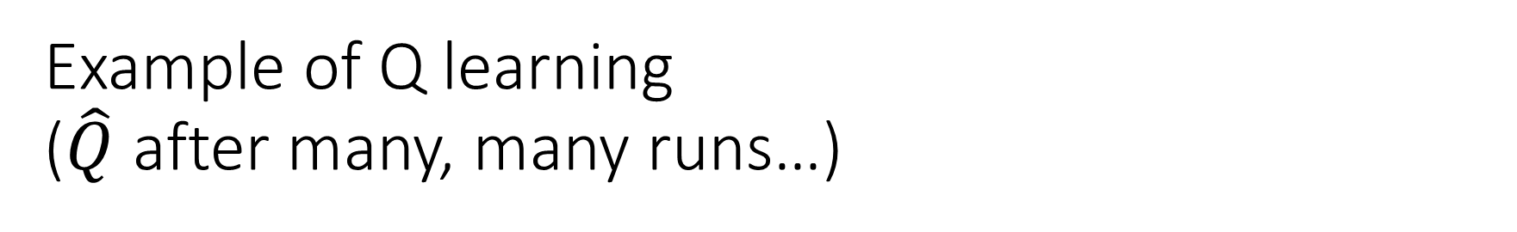
Example of Q learning
($\hat{Q}$ after many, many runs…)
0, 0
1, 0
2, 0
$\hat{Q}$ converged
Policy is:
$$π\left(s\right)=\underset{aεA_{s}}{argmax}{\hat{Q}(s,a)}$$
50
100
12.5
25
25
25
50
100
0, 1
25
1, 1
2, 1
50
6.25
12.5
12.5
25
25
12.5
25
50
0, 2
12.5
1, 2
25
2, 2
6.25
12.5

Slide 17









Challenges for Reinforcement Learning
When there are many states and actions
When the episode can end without reward
When there is a ‘narrow’ path to reward
Turns Remaining: 15
Each step ~50% probability of going wrong way – P(reaching goal) ~ 0.01%
Random exploring will fall off of rope ~97% of the time

Slide 18
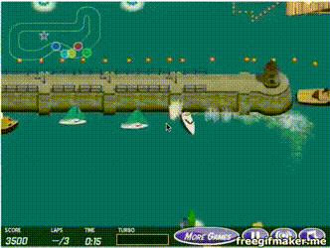
Reward Shaping
Hand craft intermediate objectives that yield reward
Encourage the right type of exploration
Requires custom human work
Risks of learning to game the rewards

Slide 19
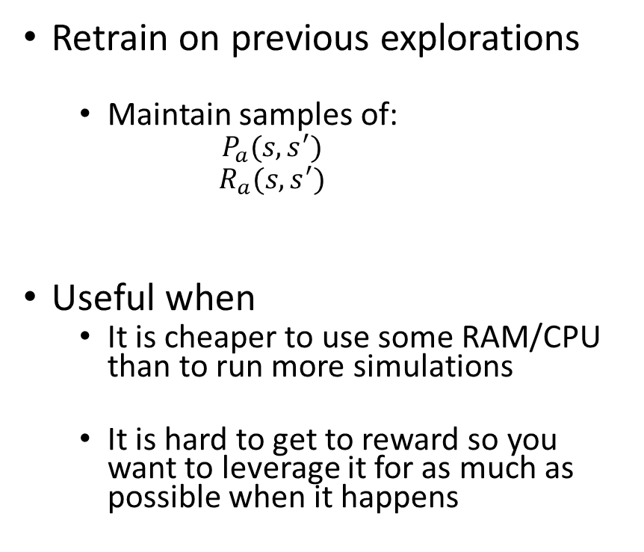
Memory
Retrain on previous explorations
  Maintain samples of:
    $$P_{a}(s, s^{′})$$
    $$R_{a}(s, s^{′})$$
Useful when
  It is cheaper to use some RAM/CPU than to run more simulations
  It is hard to get to reward so you want to leverage it for as much as possible when it happens
0, 0
1, 0
2, 0
0
50
100
0
0
0
0
25
0
50
100
0, 1
1, 1
0
25
2, 1
0
0
50
0
0
0
0
0
0
0
25
25
50
0
0, 2
1, 2
25
2, 2
0
0
0
12.5
0
Replay it a bunch of times
Do an exploration
Replay a different exploration
Replay it a bunch of times

Slide 20
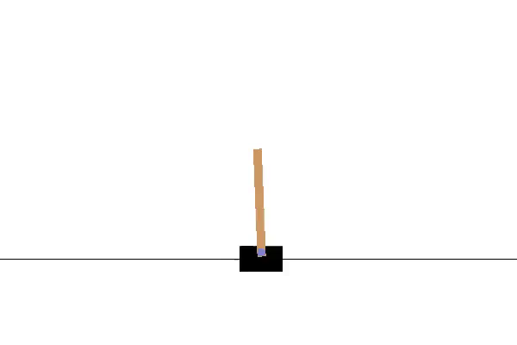
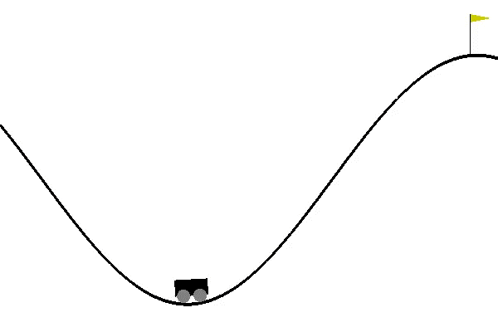
Gym – toolkit for reinforcement learning
CartPole
import gym
env = gym.make('CartPole-v0')
import random
import QLearning # Your implementation goes here...
import GymSupport
trainingIterations = 20000
qlearner = QLearning.QLearning(<Parameters>)
for trialNumber in range(trainingIterations):
observation = env.reset()
reward = 0
for i in range(300):
env.render() # Comment out to make much faster...
currentState = ObservationToStateSpace(observation)
action = qlearner.GetAction(currentState, <Parameters>)
oldState = ObservationToStateSpace(observation) # Old state = current
observation, reward, isDone, info = env.step(action)
newState = ObservationToStateSpace(observation)
qlearner.ObserveAction(oldState, action, newState, reward, …)
if isDone:
if(trialNumber%1000) == 0:
print(trialNumber, i, reward)
break
# Now you have a policy in qlearner – use it...
Reward +1 per step the pole remains up
MountainCar
Reward 200 at flag -1 per step
https://gym.openai.com/docs/

Slide 21
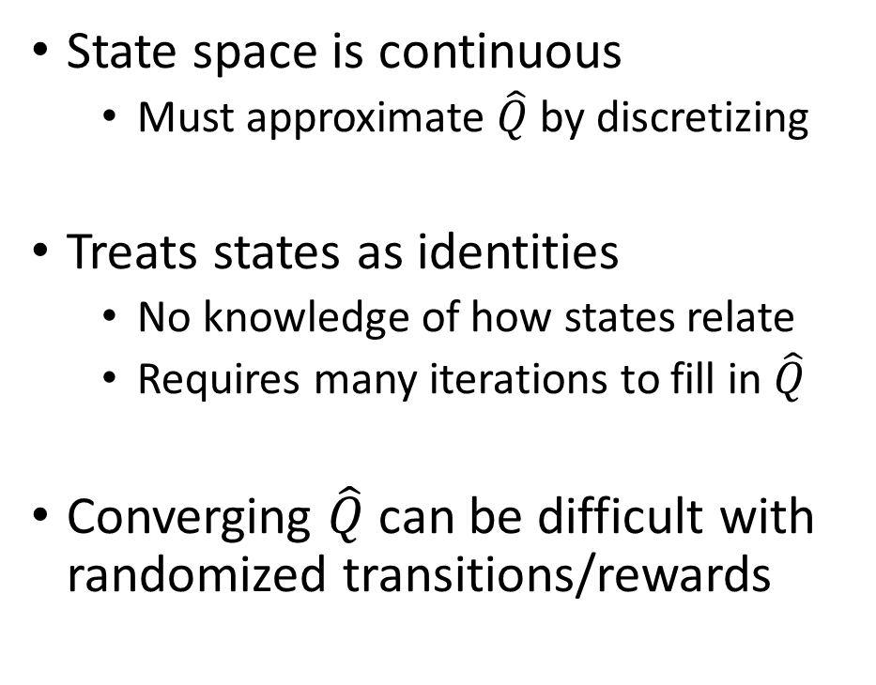
Some Problems with QLearning
State space is continuous
  Must approximate $\hat{Q}$ by discretizing
Treats states as identities
  No knowledge of how states relate
  Requires many iterations to fill in $\hat{Q}$
Converging $\hat{Q}$ can be difficult with randomized transitions/rewards
print(env.observation_space.high)
#> array([ 2.4 , inf, 0.20943951, inf]) print(env.observation_space.low)
#> array([-2.4 , -inf, -0.20943951, -inf])

Slide 22
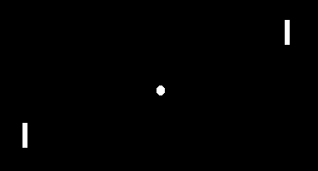
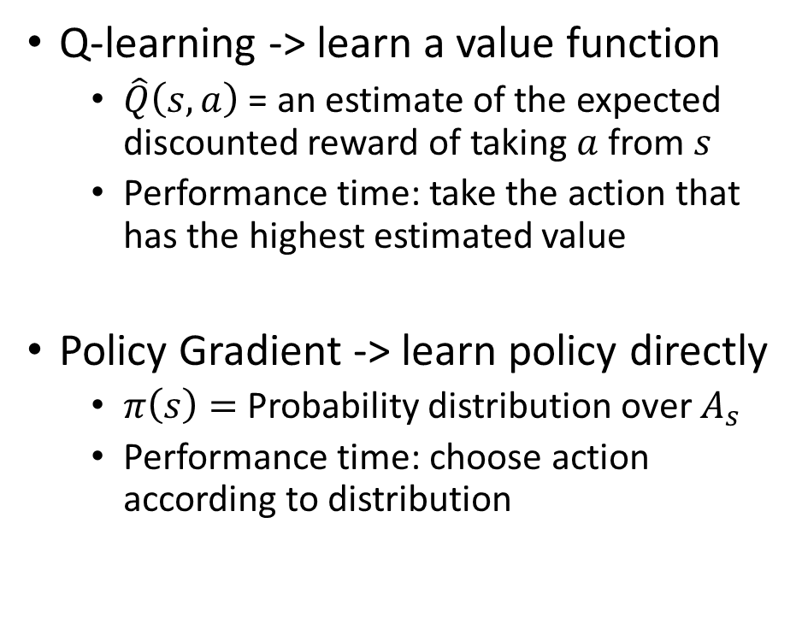
Policy Gradients
Q-learning -> learn a value function
  $\hat{Q}\left(s,a\right)$ = an estimate of the expected discounted reward of taking $a$from $s$
  Performance time: take the action that has the highest estimated value
Policy Gradient -> learn policy directly
  $π\left(s\right)=$ Probability distribution over $A_{s}$
  Performance time: choose action according to distribution
Example from: https://www.youtube.com/watch?v=tqrcjHuNdmQ

Slide 23
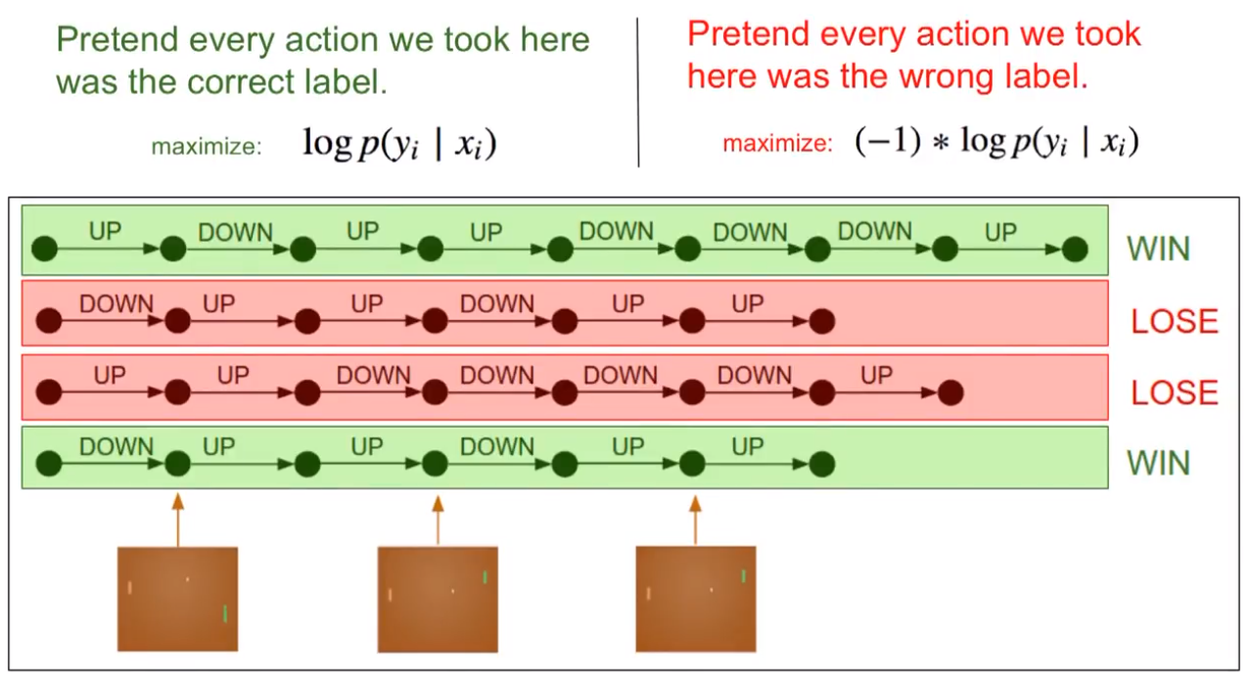
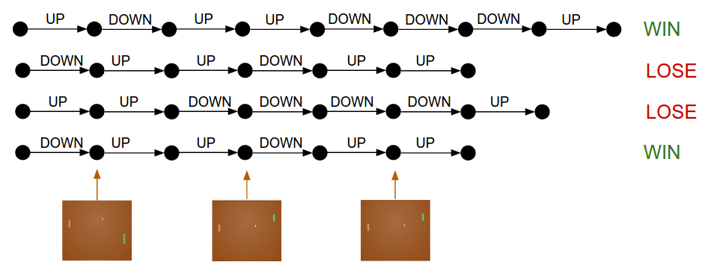
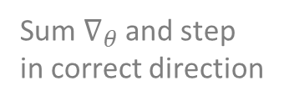
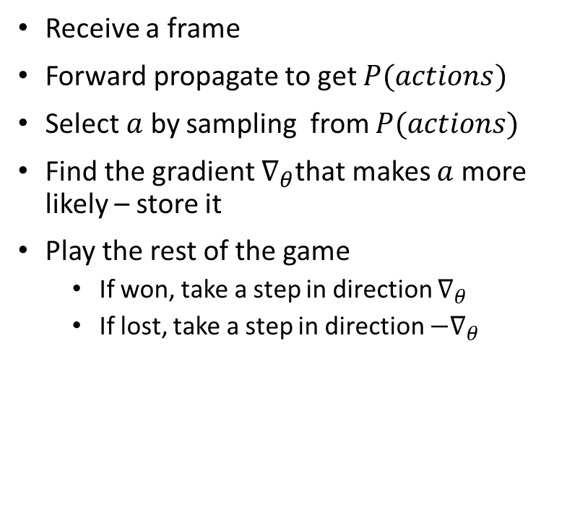

Policy Gradients
Receive a frame
Forward propagate to get $P(actions)$
Select $a$ by sampling from $P(actions)$
Find the gradient $∇_{θ}$that makes $a$ more likely – store it
Play the rest of the game
  If won, take a step in direction $∇_{θ}$
  If lost, take a step in direction ${−∇}_{θ}$
One $∇_{θ}$ per action
Sum $∇_{θ}$ and step
in correct direction

Slide 24
Policy Gradients – reward shaping
Not relevant to outcome(?)
Less important to outcome
More important to outcome

Slide 25
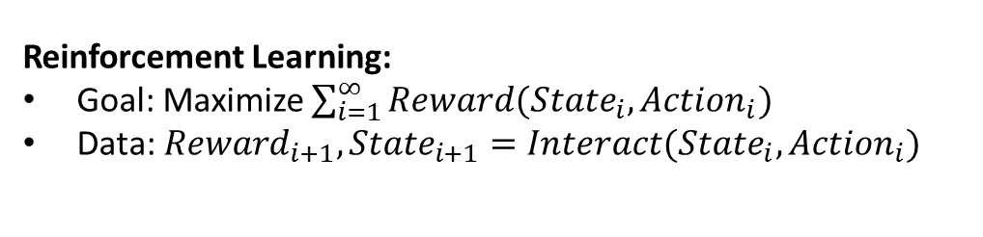
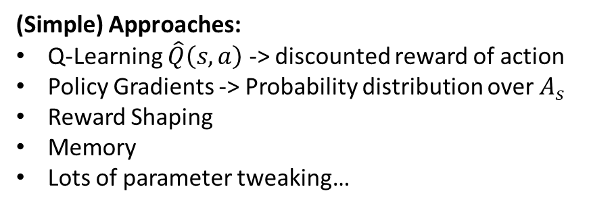
Summary
Agent
Reinforcement Learning:
Goal: Maximize $\sum_{i=1}^{∞}{Reward({{State}_{i}, Action}_{i})}$
Data: ${Reward}_{i+1}, {State}_{i+1}=Interact({State}_{i},{Action}_{i})$
Reward
State
Action
Environment
Many (awesome) recent successes:
Robotics
Surpassing humans at difficult games
Doing it with (essentially) zero human knowledge
(Simple) Approaches:
Q-Learning $\hat{Q}\left(s,a\right)$ -> discounted reward of action
Policy Gradients -> Probability distribution over $A_{s}$
Reward Shaping
Memory
Lots of parameter tweaking…
Challenges:
When the episode can end without reward
When there is a ‘narrow’ path to reward
When there are many states and actions

